Slide 1
Prediction of Term Deposit Subscription
Presented by Team 4:
Keerthi Kamarthi
Mumtaz Bano
Shruti Vyas
Sowjanya Vanga
Tejaswi Yadala

Slide 2
Agenda
Introduction to the problem
Data Collection
Data Visualization
Data Preparation
Possible Methods
Results
Future Prospect
Comparison between models

Slide 3
Introduction

Slide 4

Banking Industry
What is banking?
What is term deposit?
Importance of term deposit
Why is this a problem?

Slide 5

Data Collection

Slide 6
Source
Structure of Data Set
https://archive.ics.uci.edu/ml/datasets/Bank+Marketing.
Age
Balance
Contact Type
Education
Job
Loan
Marital Status
Number of Calls
Customer subscribed term deposit

Slide 7
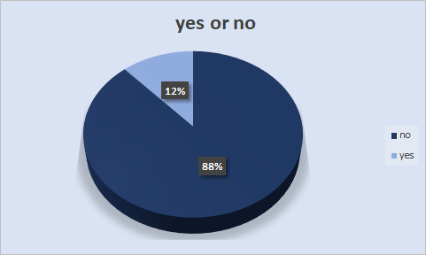
Data Visualization

Slide 8
Data Preparation

Slide 9
Imbalanced Dataset
Pipeline
- String Indexer
- One-Hot Encoding
- Vector Assembler
Feature scaling
- min max scaler

Slide 10

Machine Learning
What is it?
Supervised & Unsupervised learning models
Models chosen
Selecting features and Data split

Slide 11

Logistic Regression
Learns the probability of sample that belongs to certain class
It uses sigmoid function which maps the real numbers into range of (0,1)
Fit data on train and prediction of target.
Based on obtained probabilities, the output label of the target is determined
Evaluate on test

Slide 12
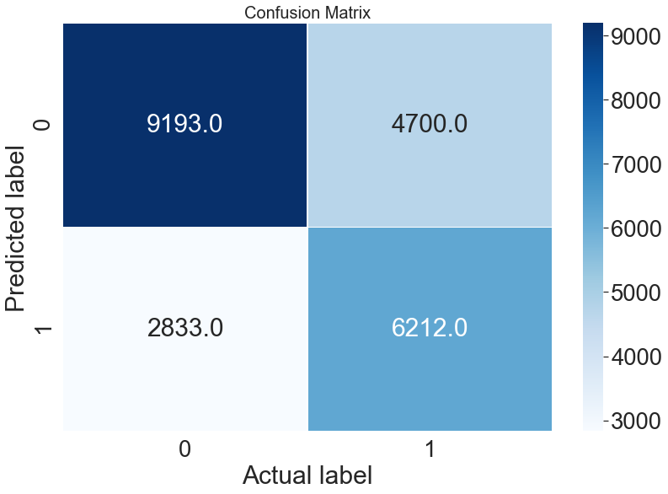
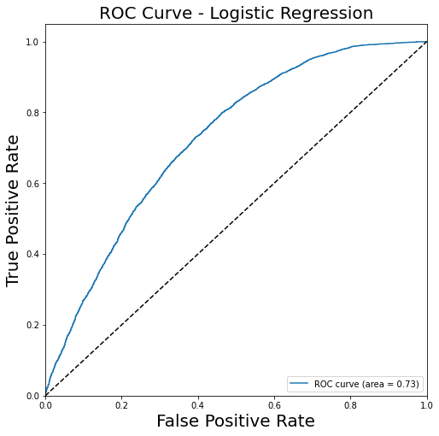
Model Evaluation
TN,FP,FN,TP
9193 2833 4700 6212
Precision: 0.690
Recall: 0.569
Accuracy: 0.68

Slide 13

Random Forest
It builds multiple decision trees and merges them together
Increases the predictive power
Increases the model's speed
Random Forest modelling

Slide 14
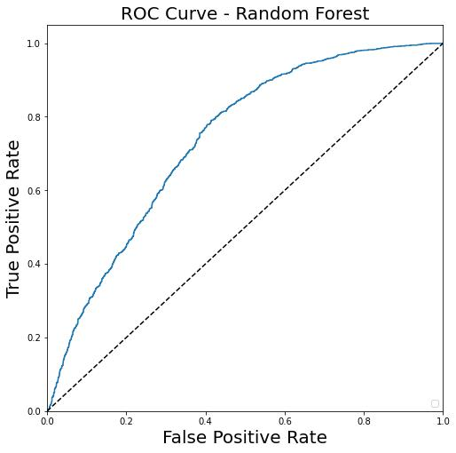
Model Evaluation
From Random Forest Algorithm
Accuracy: 0.71
Area under ROC= 0.78
From Random Forest Algorithm
Accuracy: 0.71
Area under ROC= 0.78

Slide 15
Conclusion
We choose random forest for our project
The model takes the client data from bank and generates list with predicted term subscription column
Marketing team designs next campaign based on this prediction from our model
Logistic Regression | Random Forest
Accuracy: 0.68 | Accuracy: 0.71
Area under ROC= 0.73 | Area under ROC= 0.78

Slide 16

Prospective for future Campaigns
Marital Status
Bank can target the customers based on the marital status.
Season
Focus its activity throughout fall and winter since the potential clients opted these seasons
Age
Target potential clients in their 20s or younger and 60s or older.

Slide 17
Q&A

Slide 18
Thank You

